Slide 1
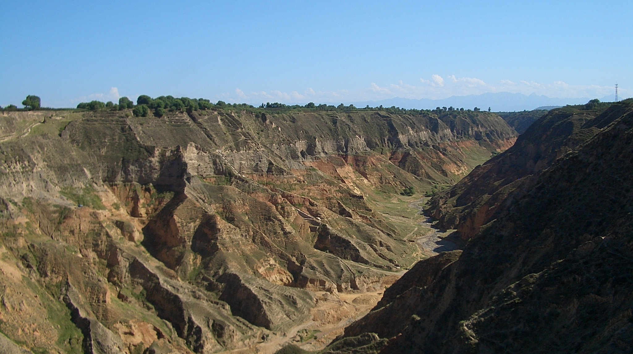
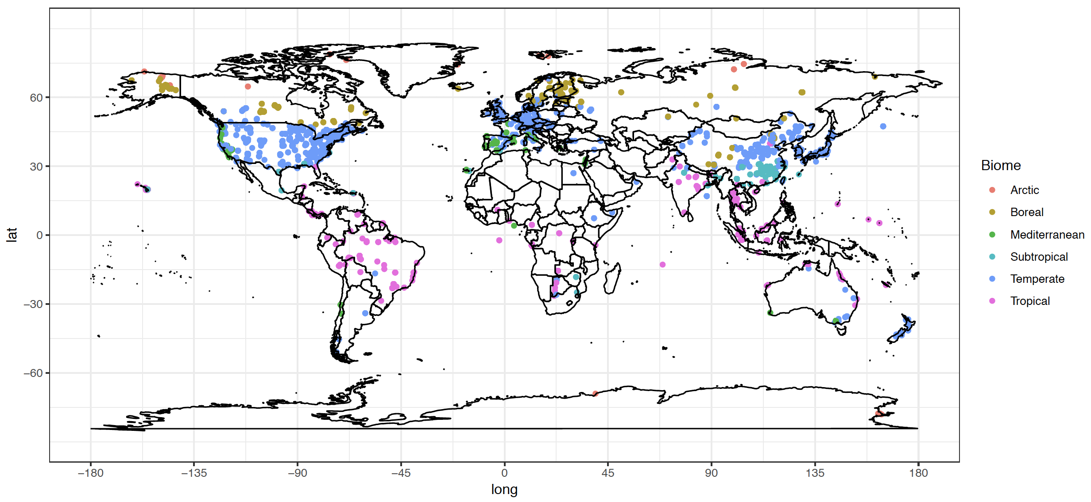
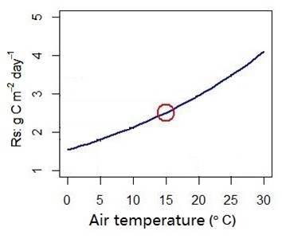
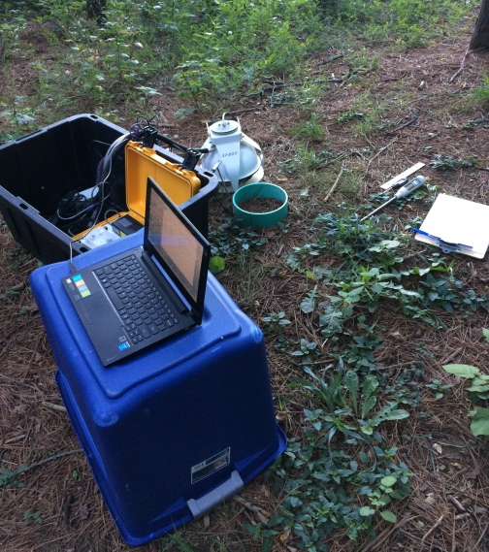
Can soil respiration measured at mean temperature represents actual soil respiration?
Jinshi Jian
PhD

Slide 2
Background
Bond-Lamberty, B.P., and A.M. Thomson. 2018. A Global Database of Soil Respiration Data, Version 4.0. ORNL DAAC, Oak Ridge, Tennessee, USA.https://doi.org/10.3334/ORNLDAAC/157
Much more Rs are measured from middle latitude region
Developed countries most located at middle latitude region, and thus more funds available
Difficult to measure Rs at cold region

Slide 3
Background
Rs measured at mean annual temperature linearly related with Rs_annual (left panel)
Rs_annual = Rs_{MAT} ^{0.926} (R2 = 0.94, p < 0.001)
Predicted Rs_annual and measured Rs_annual are closely related, with slope – 1 and intercept = 0 (right panel).
Bahn, M., Reichstein, M., Davidson, E. A., Grünzweig, J., Jung, M., Carbone, M. S., ... & Savage, K. (2010). Soil respiration at mean annual temperature predicts annual total across vegetation types and biomes. Biogeosciences, 7(7), 2147.

Slide 4
Method
SRDB_V4
Rs_annual
Rs_MAT
Rs_annual
Predicted Rs_annual
MGRsD
Bahn model
Rs_annual = Rs_{MAT} ^{0.926}
Rs_monthly
Rs_MMT
Rs_monthly
Predicted Rs_monthly
HGRsD
Rs_diurnal
Rs_MDT
Rs_diurnal
Predicted Rs_diurnal

Slide 5
Results
Slope > 1
Slope = 1
Slope = 1
TS as predictor to get Rs_MAT;
Annual mean air temperature as predictor to get Rs_MAT;
Mean annual air temperature (MAT) as predictor to get Rs_MAT.

Slide 6
Results
Slope = 1
Exclude agriculture sites, predicted Rs_annual by bahn model (Slope = 1, intercept = 0)

Slide 7
Results
Blue: Rs and Ts measured more than 8 months
Green: covered less than 8 month but more than 5 months
Red: less than 5 months coverage

Slide 8
Results
RA-dominated sites (RC_annual>0.5 is TRUE)

Slide 9
Results
SPI: Standardized Precipitation Index
(-3,-1) – Drought; (-1,1) – medium; (1-3) humid; (3,5) wet

Slide 10
Results
More precipitation variability, the regression off from the 1:1 line.

Slide 11
Results
Air temperature has no effects on the relationship

Slide 12
Results
Slope > 1

Slide 13
Results
Slope > 1
(a)
(b)
(c)
Predicted diurnal Rs vs measured diurnal Rs;
Rs when soil reach diurnal mean soil temperature vs diurnal mean Rs ;
Histogram shows the frequency when soil reaches its diurnal mean soil temperature.
Slope = 1

Slide 14
Results

Slide 15
Thanks Comments and suggestions?

